Slide 1
FAKE VOICE DETECTION Deepfake Detection using Convolutional Neural Networks (CNNs)
Presented by:
Bhagavan Dheeravath

Slide 2
Introduction
Fake Voice Detection is a specialized application of artificial intelligence focused on identifying audio that has been artificially generated or manipulated to imitate real human speech.
With the rise of deepfake technology and advancements in AI, creating synthetic voices has become easier, posing potential risks to security, privacy, and trust.
Why Detect Fake Voices?
Preventing Identity Theft and Fraud: Impersonating voices could enable scammers to breach secure systems or gain unauthorized access to sensitive information.
Protecting Reputation: Public figures and ordinary individuals alike are at risk of voice manipulation being used to falsely attribute statements.
Ensuring Authentic Communication: Organizations and individuals rely on authentic communication for effective decision-making. Detecting fake voices ensures that the content shared is genuine.

Slide 3
Project Objectives
Goal:
The primary objective of this project is to detect deepfake audio through an AI model built using Convolutional Neural Networks (CNNs). The model is trained to perform binary classification, distinguishing between “Real” and “Fake” audio samples.
This project focuses on audio deepfakes due to the increasing number of instances where fake voices are used to impersonate individuals, making it critical to have reliable tools to verify authenticity.

Slide 4
RESEARCH ARTICLE
Audio Deepfake detection: A Survey JOURNAL OF LATEX CLASS FILES, VOL. 14, NO. 8, AUGUST 2023 Jiangyan Yi, Member, IEEE, Chenglong Wang, Jianhua Tao, Senior Member, IEEE, Xiaohui Zhang, Chu Yuan Zhang, and Yan Zhao
Summary: - This survey paper provides a comprehensive overview of current developments in audio deepfake detection, addressing key topics such as datasets, features, classification methods, and evaluation techniques. It analyzes differences among deepfake audio types and reviews advancements, challenges, and limitations in the field. A unified comparison of detection methods is conducted on ASVspoof 2021, ADD 2023, and In-the-Wild datasets. The findings highlight critical areas for future research, including the need for larger, more diverse datasets, improved generalization to unknown fake attacks, and better interpretability of detection results

Slide 5
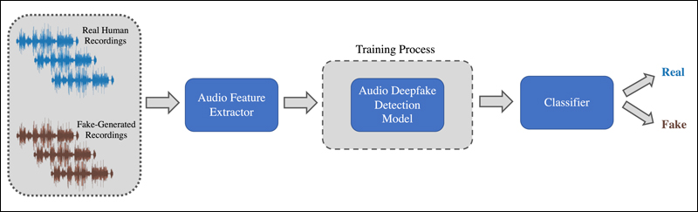
Project flow

Slide 6
Dataset Overview
Dataset Source:
Kaggle - Balanced Dataset for Deepfake Detection: This dataset was sourced from Kaggle, specifically designed for deepfake voice detection. It includes labeled audio data, structured to provide balanced representation for training and testing deepfake detection models.
Features:
The dataset contains 26 key audio features extracted from each audio sample. These features capture critical characteristics of the sound, aiding the model in distinguishing real audio from synthetic (fake) audio. The main features include:
Chroma STFT: Captures the intensity of the 12 different pitch classes, helping to analyze pitch variation.
RMS (Root Mean Square Energy): Measures the loudness or energy of the audio signal.

Slide 7
Con…
Spectral Centroid: Indicates where the “center of mass” of the spectrum is, often correlated with the perceived brightness of a sound.
Spectral Bandwidth: Describes the range of frequencies present in the audio, providing insight into its tonal richness.
Rolloff: Represents the frequency below which a certain percentage of the total spectral energy lies, often used to detect tonal properties.
Zero Crossing Rate: Measures the rate at which the audio signal changes sign, useful for identifying noisy or percussive sounds.
MFCCs (Mel-frequency Cepstral Coefficients): 20 features (MFCC1 through MFCC20) that capture the power spectrum of audio signals. MFCCs are a cornerstone in audio analysis, especially in distinguishing voice characteristics since they mimic human auditory perception.
This is a balanced dataset, meaning it contains an approximately equal number of real and fake samples
Binary Classification:
“Real”: Genuine audio samples, representing actual human voices.
“Fake”: Deepfake-generated audio samples, created by AI to mimic real voices.

Slide 8
Exploratory Data Analysis (EDA)
Waveform Visualization
Real Audio Visualization: The waveform of the real audio sample is plotted to provide a visual representation of the amplitude of the audio signal over time. This visualization helps in understanding the overall structure of the audio, such as the presence of silence, varying amplitude levels, and potential features indicative of authenticity.
Fake Audio Visualization: Similarly, the waveform of the fake audio is plotted. By comparing the two waveforms, we can observe differences in amplitude variations, which may indicate the nature of manipulation in fake audio.

Slide 9
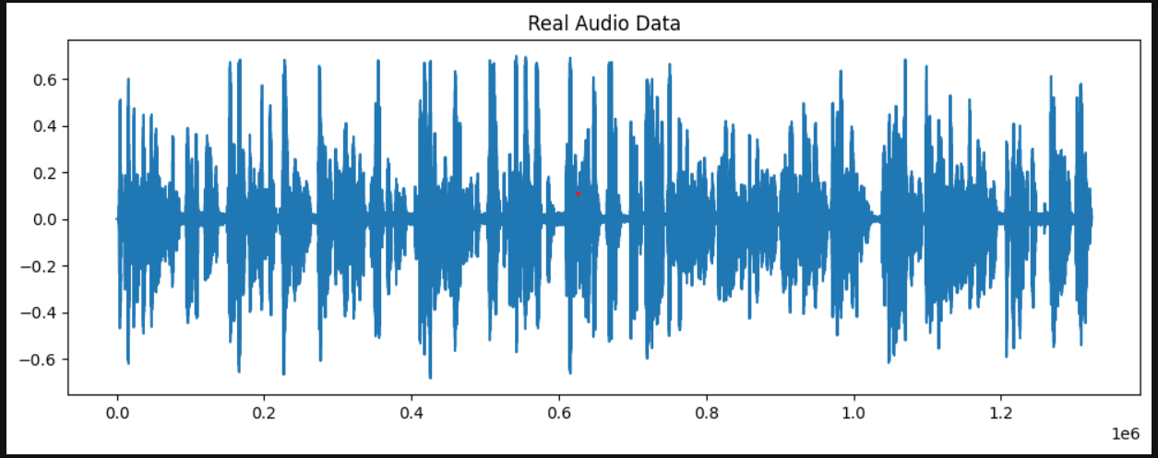
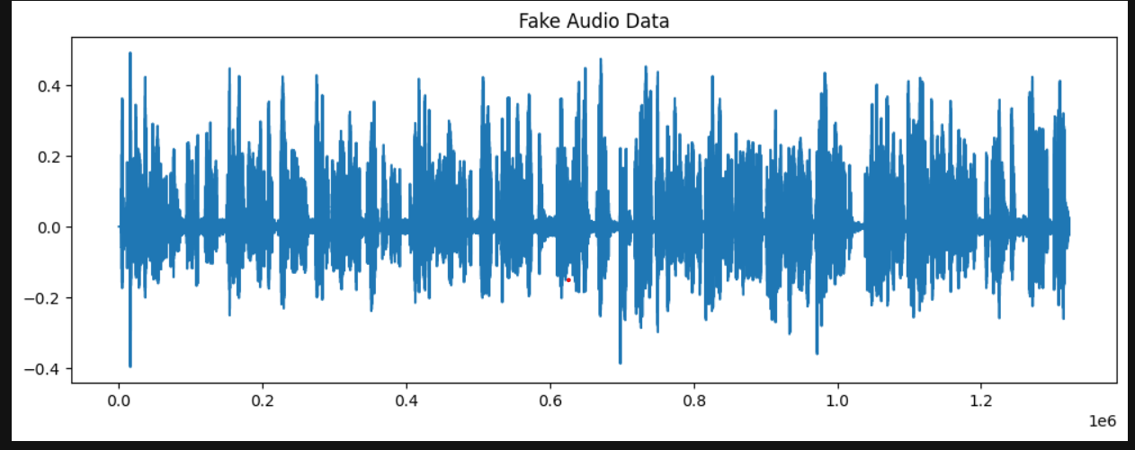
Waveform Visualization

Slide 10
Data Preprocessing
Label Encoding: Describe how LabelEncoder is used to convert labels to binary values (0 for Real, 1 for Fake).
Feature Scaling: Standardize the data using StandardScaler to achieve consistency in feature range.
Data Reshaping: Reshape the scaled data to a format suitable for CNN: (samples, 1, 26, 1).
Train-Test Split
Splitting Strategy: Explain the train_test_split function with an 80-20 ratio for training and testing.
Importance of Splitting: Why separating training and test data is essential to prevent data leakage and ensure fair model evaluation.
Sample Counts: Show sample counts for each set to confirm split (e.g., Training samples: 8000, Testing samples: 2000).

Slide 11
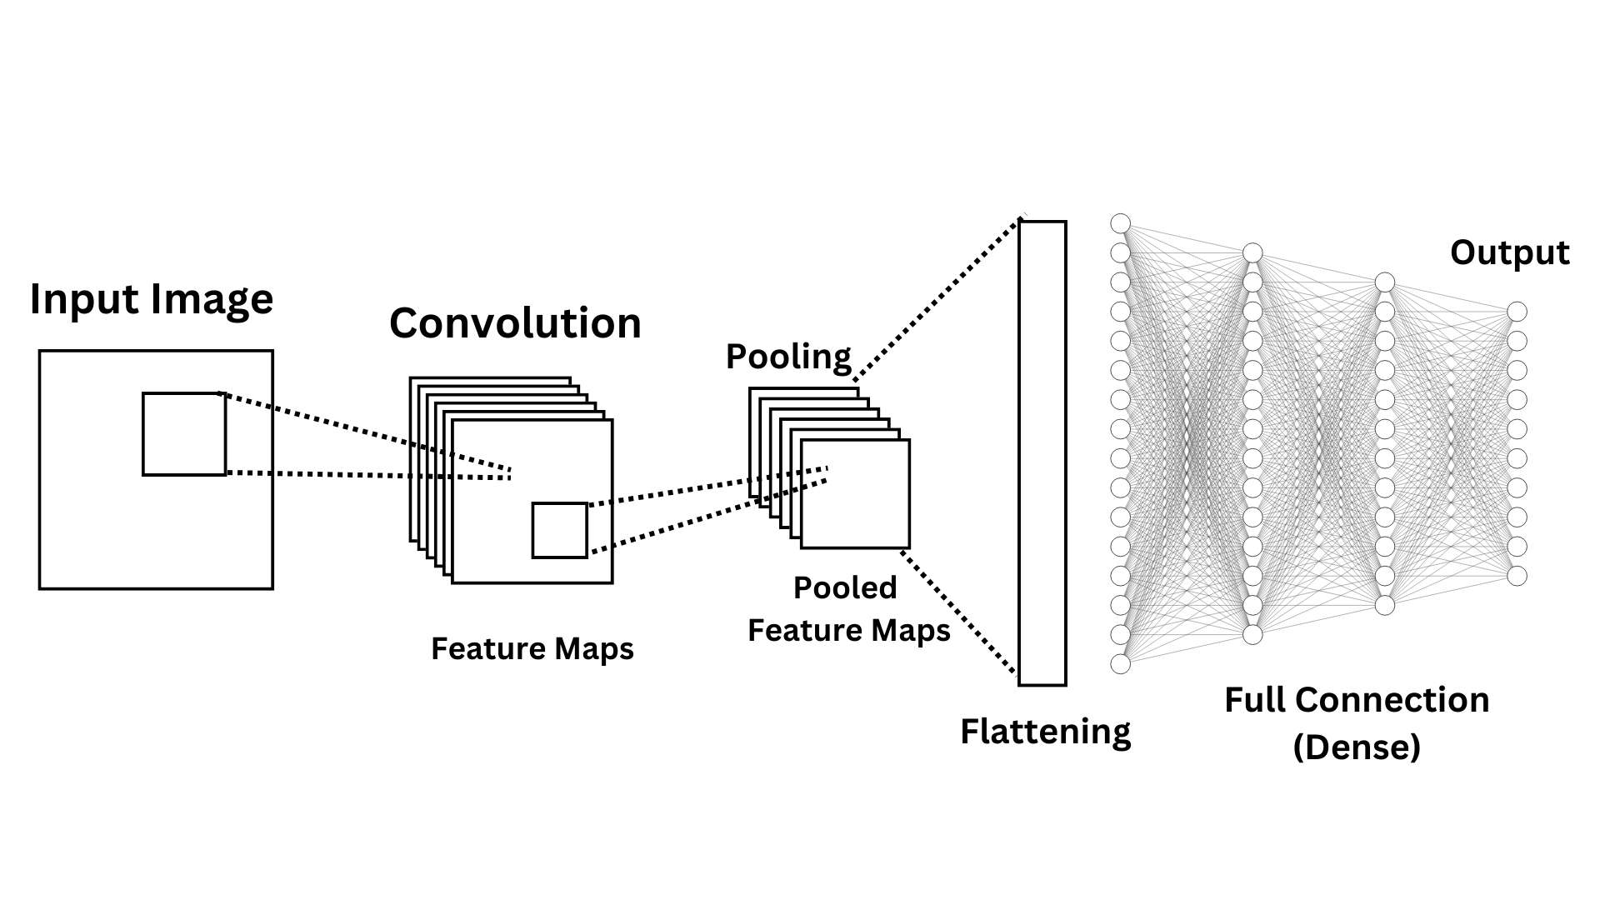
CNN Model Architecture

Slide 12
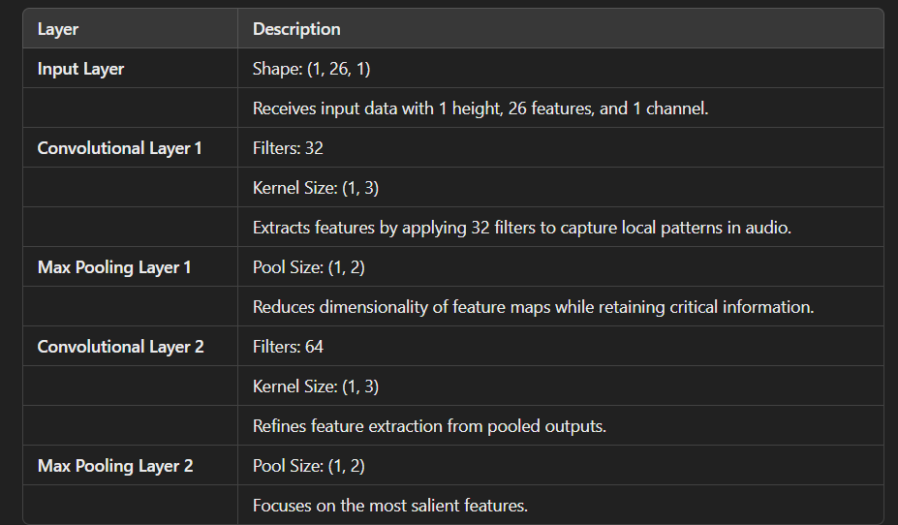
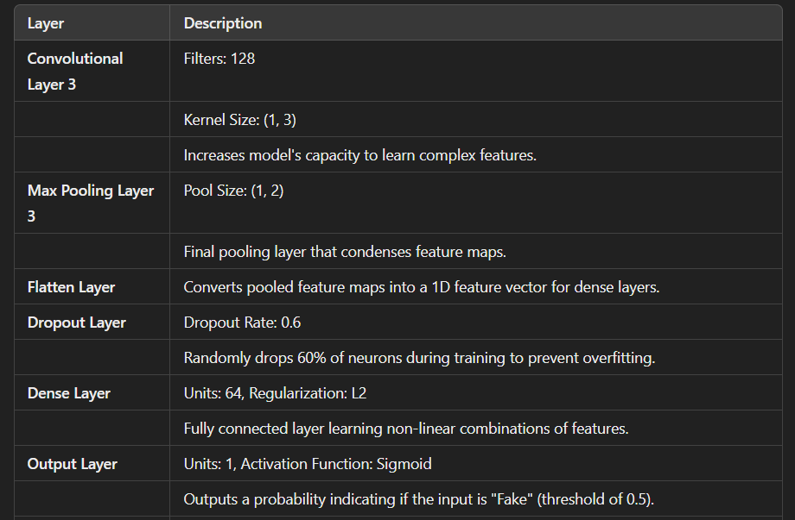
CNN Overview for Deepfake Detection

Slide 13
Training Setup and Callbacks
The loss function used in this model is Binary Crossentropy, which is particularly suitable for binary classification tasks. This loss function calculates the difference between the predicted probabilities output by the model and the actual binary labels (0 or 1).
Optimizer: The Adam Optimizer is employed, providing adaptive learning rate adjustments that facilitate faster convergence and better performance on complex datasets. Its efficiency is particularly beneficial in scenarios with large-scale data and high-dimensional feature spaces.
Metrics: The training process tracks accuracy as a primary metric, assessing the proportion of correct predictions made by the model. Monitoring accuracy helps evaluate the model’s performance over time and informs any necessary adjustments to the training strategy.

Slide 14
Early Stopping and Model Checkpointing
Early Stopping: This technique monitors validation loss during training and halts the process if there is no improvement after a specified number of epochs, which helps mitigate overfitting. By stopping at the optimal point, it ensures the model generalizes well to unseen data.
Model Checkpointing: The best-performing model is saved during training using model checkpointing, which captures the model's weights at specified intervals. This approach allows for recovery from interruptions and ensures that the most effective model configuration is retained for future use.

Slide 15
Training Process Overview
Epochs and Batch Size: The model is trained for 20 epochs, allowing for 20 complete passes through the dataset, while the batch size is set to 32, meaning the model updates its weights after processing 32 samples at a time. These parameters help control the learning dynamics and resource usage during training.
Validation Split: A portion of the training data is reserved as a validation split to evaluate the model’s performance on unseen data throughout the training process. This validation helps ensure that the model does not overfit to the training data and can effectively generalize to new instances.

Slide 16
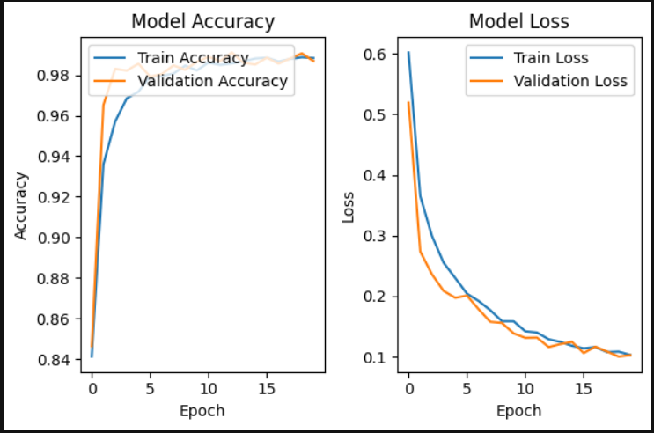
Training Curves and Performance Visualization
Accuracy Curves
Training vs. Validation Accuracy: Plot of training accuracy and validation accuracy over epochs.
Insights: Interpretation of the curves to check for signs of overfitting or underfitting.
Loss Curves
Training vs. Validation Loss: Plot of loss across epochs for training and validation sets.
Analysis: Look for stable loss, indicating that the model has converged effectively.

Slide 17
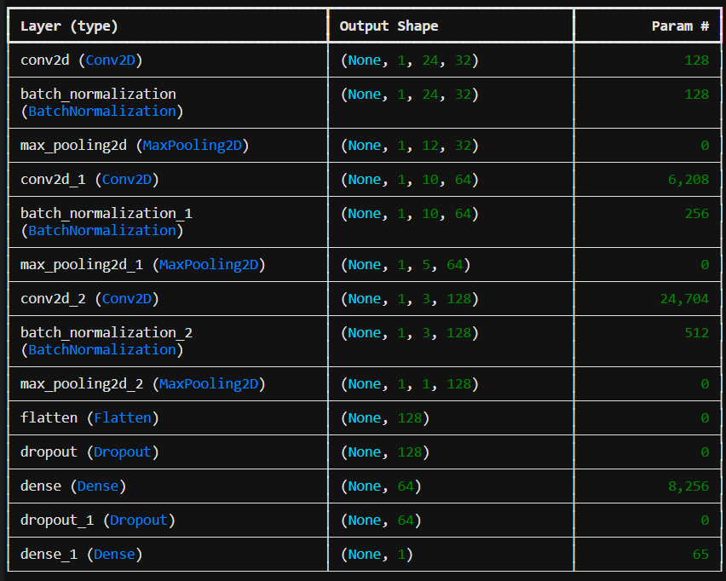
Model Summary Output

Slide 18
Conclusions
The CNN-based model effectively classifies real versus fake audio samples, achieving high accuracy and balanced metrics. Feature extraction techniques, such as MFCCs, chroma features, and mel spectrograms, proved crucial in distinguishing between classes.

Slide 19
Future Enhancements
Potential Improvements: To further enhance model performance, training on a larger and more diverse dataset is essential. A more extensive dataset would allow the model to learn from a wider variety of audio characteristics, improving its ability to generalize and perform well on unseen samples.
Experimenting with Hybrid Models: Future work could involve developing hybrid models that combine the strengths of both CNNs and Recurrent Neural Networks (RNNs). By integrating RNN layers, the model can effectively capture temporal patterns in audio data, enabling it to better understand how features change over time.
Broader Applications: The technology developed for deepfake detection has potential applications beyond audio verification. It could be adapted for use in fraud detection systems, where identifying manipulated audio in financial transactions is critical.

Slide 20

Thank you

